Slide 1
Final Project prep Site Map
CAS 206 Justin Meas
Purpose:
This website will show case ducks.
Breeds, colors, living conditions, survival, etc.
I am making this site for people to get a better understanding of ducks. For people to learn a thing or two about ducks.
Addressing opportunity:
This website is targeted to provide informative information about ducks. This website can reach to inform people about caring for ducks as close as any other pet and not just another type of animal.
Desired accomplishments:
My goal is to show off ducks. There are many different types of dogs in the world but this page is to show off the various types of ducks.
This site will include a lot of photos with reasoning. Its purpose is to inform and show how a duck lives.
Content:
Readable font
Informative Description with Youtube links and images
Many pictures of ducks and pictures relating to duck characteristics.
Target audience:
Anyone and everyone, ages 4-100
Kids, teens, adult teens, adults, elderly, both male/female.
Similar Website:
https://www.thespruce.com/fun-facts-about-ducks-387094
https://www.britannica.com/animal/duck

Slide 2
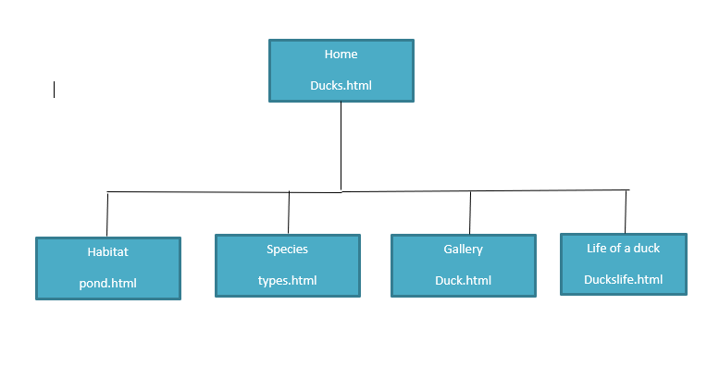

Slide 3
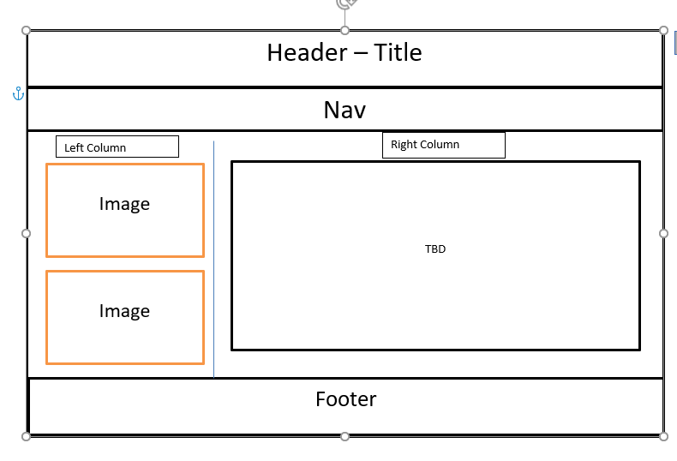
Desktop layout
All contained in a wrapper

Slide 4
Tablet Layout
All contained in a wrapper

Slide 5
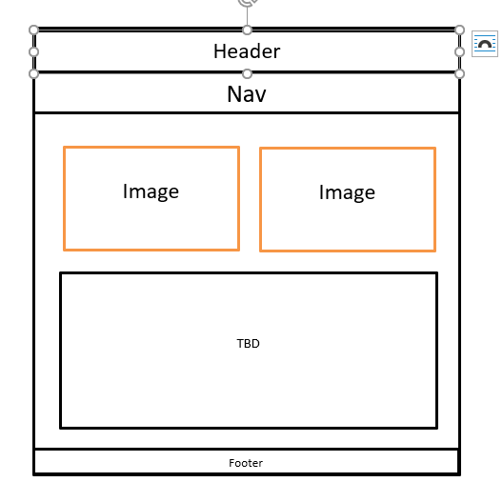
Mobile Layout
All contained in a wrapper

